Slide 1


Discrete Mathematics
Mathematical Logic

Slide 2
Mathematical Logic
Definition: Methods of reasoning, provides rules and techniques to determine whether an argument is valid
Theorem: a statement that can be shown to be true (under certain conditions)
Example: If x is an even integer, then x + 1 is an odd integer
This statement is true under the condition that x is an integer is true
2

Slide 3
Mathematical Logic
A statement, or a proposition, is a declarative sentence
that is either true or false, but not both
Uppercase letters denote propositions
Examples:
P: 2 is an even number (true)
Q: 7 is an even number (false)
R: A is a vowel (true)
The following are not propositions:
P: My cat is beautiful
Q: My house is big
3

Slide 4
Propositions
A statement that has a truth value
Which of the following are propositions?
The Washington State flag is red
It snowed in Whistler, BC on January 4, 2008.
Hillary Clinton won the democratic caucus in Iowa
Space aliens landed in Roswell, New Mexico
Ron Paul would be a great president
Turn your homework in on Wednesday
Why are we taking this class?
If n is an integer greater than two, then the equation a^{n} + b^{n}
= c^{n} has no solutions in non-zero integers a, b, and c.
Every even integer greater than two can be written as the sum of two primes
This statement is false
Propositional variables: p, q, r, s, . . .
Truth values: T for true, F for false

Slide 5
Mathematical Logic
Truth value
One of the values “truth” (T) or “falsity” (F)
assigned to a statement
Negation
The negation of P, written
¬P, is the statement
obtained by negating statement P
Example:
P: A is a consonant
¬P: it is the case that A is not a consonant
Truth Table
P
¬P
T F
F T

Slide 6
Mathematical Logic
Conjunction
Let P and Q be statements.The conjunction of P and Q, written P ^ Q , is the statement formed by joining statements P and Q using the word “and”
The statement P ^ Q is true if both p and q are true; otherwise P ^ Q is false
Truth Table for Conjunction:
P | Q | P ˄ Q
F | F | F
F | T | F
T | F | F
T | T | T

Slide 7
Mathematical Logic
Disjunction
Let P and Q be statements. The disjunction of P and Q, written P v Q , is the statement formed by joining statements P and Q using the word “or”
The statement P v Q is true if at least one of the
statements P and Q is true; otherwise P v Q is false
The symbol v is read “or”
Truth Table for Disjunction:
P | Q | P ˅ Q
F | F | F
F | T | T
T | F | T
T | T | T

Slide 8
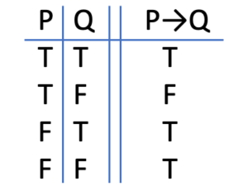
Conditional Statement
Implication
Let P and Q be statements.The statement “if P then Q” is called an implication or condition.
The implication “if P then Q” is written P → Q
P is called the hypothesis, Q is called the conclusion
Truth Table for Implication:

Slide 9
Mathematical Logic
Implication
Let P: Today is Sunday and Q: I will wash the car.
P → Q :
If today is Sunday, then I will wash the car
The converse of this implication is written Q → P
If I wash the car, then today is Sunday
The inverse of this implication is
¬P → ¬Q
If today is not Sunday, then I will not wash the car
The contrapositive of this implication is ¬Q → ¬P
If I do not wash the car, then today is not Sunday

Slide 10
Mathematical Logic
Biimplication
Let P and Q be statements. The statement “P if and only if
Q” is called the biimplication or biconditional of P and Q
The biconditional “P if and only if Q” is written P ↔ Q
“P if and only if Q”
Truth Table for the Biconditional:
P | Q | P ↔ Q
F | F | T
F | T | F
T | F | F
T | T | T

Slide 11
Precedence of Logical Operators
We can use parentheses to specify the order in which logical operators in a compound proposition are to be applied.
To reduce the number of parentheses, the precedence order is defined for logical operators.
In general, 2n rows are required if a compound proposition involves n propositional variables in order to get the combination of all truth values.
Precedence of Logical Operators.
Operator
¬
Λ
ν
→
↔
Precedence
1
2
3
4
5
E.g. ¬p Λ q = (¬p ) Λ q
p Λ q ν r = (p Λ q ) ν r p ν q Λ r = p ν (q Λ r)

Slide 12
Mathematical Logic
Precedence of logical connectives is:
¬ highest
^ second highest
v third highest
→ fourth highest
↔ fifth highest

Slide 13
English and Logic
You cannot ride the roller coaster if you are under 4 feet tall unless you are older than 16 years old
q: you can ride the roller coaster
r: you are under 4 feet tall
s: you are older than 16
( r ∧ ¬ s) → ¬ q
¬ s → (r → ¬ q)

Slide 14
Mathematical Logic
A compound proposition is a
Tautology if it is always true
Contradiction if it is always false
Contingency if it can be either true or false

Slide 15
compound proposition
We can use connectives to build up complicated compound propositions involving any number of propositional variables, then use truth tables to determine the truth value of these compound propositions.
Example: Construct the truth table of the compound proposition (p ν ¬q) → (p Λ q).
The Truth Table of (p ν ¬q) → (p Λ q).
p | q | ¬q | p ν ¬q | p Λ q | (p ν ¬q) → (p Λ q)
T | T | F | T | T | T
T | F | T | T | F | F
F | T | F | F | F | T
F | F | T | T | F | F

Slide 16
Propositional Logic
Logic and Bit Operations
Computers represent information using bits.
A bit is a symbol with two possible values, 0 and 1.
By convention, 1 represents T (true) and 0 represents F (false).
A variable is called a Boolean variable if its value is either true or false.
Bit operation – replace true by 1 and false by 0 in logical operations.
Table for the Bit Operators OR, AND, and XOR.
x | y | x ν y | x Λ y | x | ⊕ y
0 | 0 | 0 | 0 |  | 0
0 | 1 | 1 | 0 |  | 1
1 | 0 | 1 | 0 |  | 1
1 | 1 | 1 | 1 |  | 0
14

Slide 17
Propositional Logic
DEFINITION 7
A bit string is a sequence of zero or more bits. The length of this string is the number of bits in the string.
● Example: Find the bitwise OR, bitwise AND, and bitwise XOR of the bit string 01 1011 0110 and 11 0001 1101.
Solution:
01 1011 0110
11 0001 1101
11 1011 1111 | bitwise OR
01 0001 0100 | bitwise AND
10 1010 1011 | bitwise XOR
17

Slide 18
Propositional Equivalences
Introduction
DEFINITION 1
A compound proposition that is always true, no matter what the truth values of the propositions that occurs in it, is called a tautology. A compound proposition that is always false is called a contradiction. A compound proposition that is neither a tautology or a contradiction is called a contingency.
Examples of a Tautology and a Contradiction.
p ¬p p ν ¬p p Λ ¬p
T F
F T
T T
F F
18

Slide 19
Propositional Equivalences
Logical Equivalences
DEFINITION 2
The compound propositions p and q are called logically equivalent if p ↔ q is a tautology. The notation p ≡ q denotes that p and q are logically equivalent.
Compound propositions that have the same truth values in all possible cases are called logically equivalent.
Example: p → q and ¬ p ∨ q are logically equivalent
Truth tables are the simplest way to prove such facts.
We will learn other ways later.
Example
Show that ¬p ν q
and p → q
are logically equivalent.
Truth Tables for ¬p ν q and p → q .
p | q | ¬p | ¬p ν q | p → q
T | T | F | T | T
T | F | F | F | F
F | T | T | T | T
F F
T
T
T
17

Slide 20
Equivalence of formulas
Let there be two formulas A & B
Then A & B are said to be equivalent to each other if their truth values are equal
┐┐P = P
P VP = P
(P V ┐P)VQ = T
P V ┐P = Q V ┐Q

Slide 21
Mathematical Logic
Logically Implies ( Tautological Implications)
A statement formula A is said to logically imply a statement formula B if the statement formula A → B is a tautology. If A logically implies B, then symbolically we write A B
Logically Equivalent
A statement formula A is said to be logically equivalent
to a statement formula B if the statement formula
A ↔ B is a tautology. If A is logically equivalent to B , then symbolically we write A ⇔ B

Slide 22
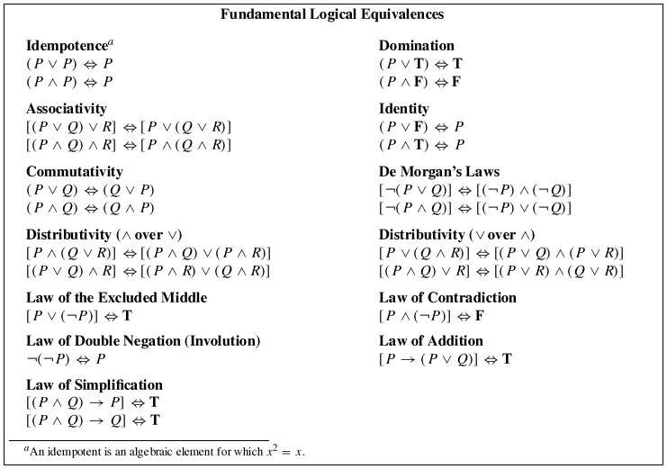

Slide 23
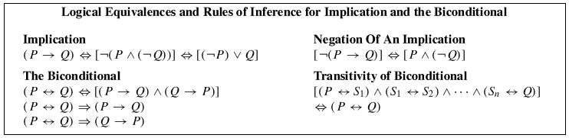
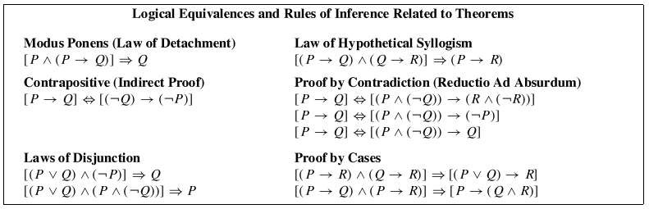

Slide 24
Show that ¬(p → q ) and p Λ ¬q are logically equivalent
¬(p → q ) ≡ ¬(¬p ν q)
≡ ¬(¬p) Λ ¬q
≡ p Λ ¬q

Slide 25
Functionally complete set of connectives
{¬,∧,∨,⟹}{¬,∧,∨,⟹}: Not, And, Or and Implies
{¬,∧,∨,⟹}{¬,∧,∨,⟹}: Not, And, Or and Implies
{¬,∧,∨,⟹}{¬,∧,∨,⟹}: Not, And, Or and Implies
{¬,∧,∨}{¬,∧,∨}: Not, And and Or
Any set of connectives in which every formula is expressed in terms of an equivalent formula containing connectives from this set
p → q = ¬p ν q
p Q
p ↔ Q

Slide 26
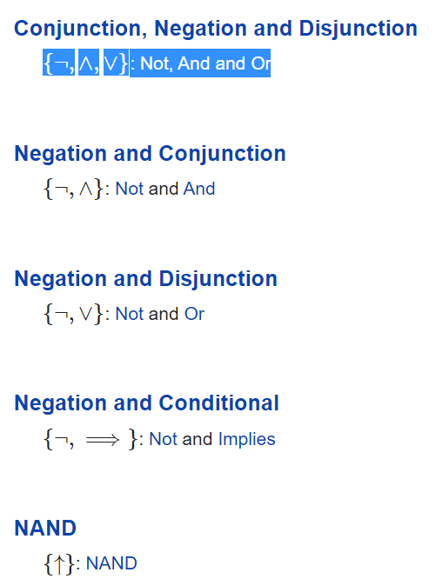

Slide 27
logical NAND
The logical NAND is an operation on two logical values, typically the values of two propositions, that produces a value of false if both of its operands are true. In other words, it produces a value of true if at least one of its operands is false.
The truth table for p NAND q (also written as p ↑ q, Dpq, or p | q) is as follows:
Logical NAND
p | q | p ↑ q
T | T | F
T | F | T
F | T | T
F | F | T

Slide 28
logical NOR
The logical NOR is an operation on two logical values, typically the values of two propositions, that produces a value of true if both of its operands are false.
I
n other words, it produces a value of false if at least one of its operands is true. ↓ is also known as the Peirce arrow after its inventor, Charles Sanders Peirce
The truth table for p NOR q (also written as p ↓ q, or Xpq) is as follows:
p | q | p ↓ q
T | T | F
T | F | F
F | T | F
F | F | T

Slide 29
Polish Notations
PREFIX NOTATIONS OPERATOR OP1 OP2
V P Q
INFIX NOTATIONS OP1 OPERATOR OP2
P V Q
POSTFIX NOTATIONS OP1 OP2 OPERATOR
P Q V

